Slide 1

DATASET
World Population 1960-2018
Link: https://www.kaggle.com/imdevskp/world-population-19602018?select=population_total_long.csv
Countries-Continents
Link:
https://github.com/dbouquin/IS_608/blob/master/NanosatDB_munging/Countries-Continents.csv

Slide 2
Data Set Description
Description: This dataset gives the information about the various factors of countries and regions from 1960 to 2018.
The dataset contains information about the name of different Countries, Fertility Rate, Density, Population, Land Area, migrants, etc.
There are in total 250(approx. : due to different datasets used)observations with 15(combining from all datasets) variables.

Slide 3
Dataset Overview
After observing the dataset, there are some major factors such as country, population, fertility rate and density from which can be extracted insights and meaningful patterns from the data.
I have also taken another dataset named country-continent and have used this dataset to combine countries continent-vise to be used in certain visualizations.
To get more knowledge about the data we have created some questions from which we can get the clear relationships among different parameters.

Slide 4

Questions for visualization
Q1: Highest and Lowest Number Of Migrants Country Vise
Q2: TOP 10 Countries by Land Area(Km²) with Continent Factor
Q3: TOP 10 Yearly Total Population Country Vise
Q4: Top 20 Countries by Density(P/Km²)
Story Part: Relation of Age, Yearly % Increase Rate and Fertility Rate

Slide 5
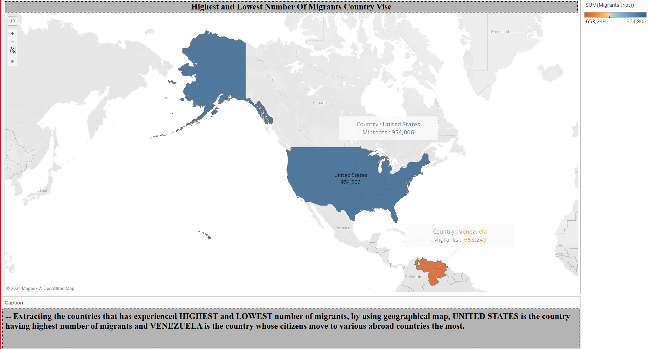
Q.1 - Visualization

Slide 6
Question 1 : Highest and Lowest Number Of Migrants Country Vise
I formed the visualization at the beginning to have insights of migrants of various countries.
But, instead of leading us to a conclusion, the graph was messed up due to ample of information.
Hence, we finally decided to conclude the country receiving highest migrants and the one whose citizens move to other countries the most.
These countries are ‘The United States of America’ and ‘Venezuela’ respectively.

Slide 7
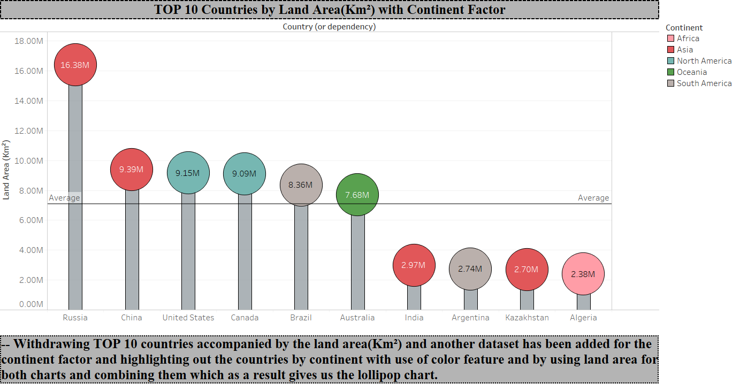
Q.2 - Visualization

Slide 8
Question 2 : TOP 10 Countries by Land Area(Km²) with Continent Factor
From the lollipop chart, it can be concluded that two countries with highest land area are from Asia(Russia and China) followed by two countries from North America(USA and Canada).
It can be clearly observed that land area of Russia is almost 1.75 times than that of China which is on the second position in terms of land area.
The reference line in the above chart shows the average land area of TOP 10 countries which is nearly same as average land area of Brazil and Australia.

Slide 9
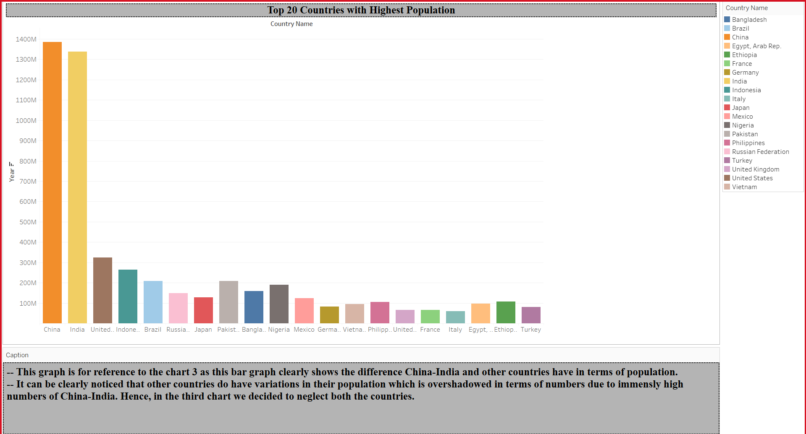
Q.3(Duplicate) - Visualization

Slide 10
Question 3(Duplicate) : Top 20 Countries with Highest Population
It can be observed from the above graph that there is a huge difference In population of USA(3rd highest) and China and India.
Hence, while creating the visualization of the original question, I decided to neglect China and India as to get better insights of data.
Also, China and India were on 1st and 2nd places respectively in terms of population throughout the period(1960-2017).

Slide 11
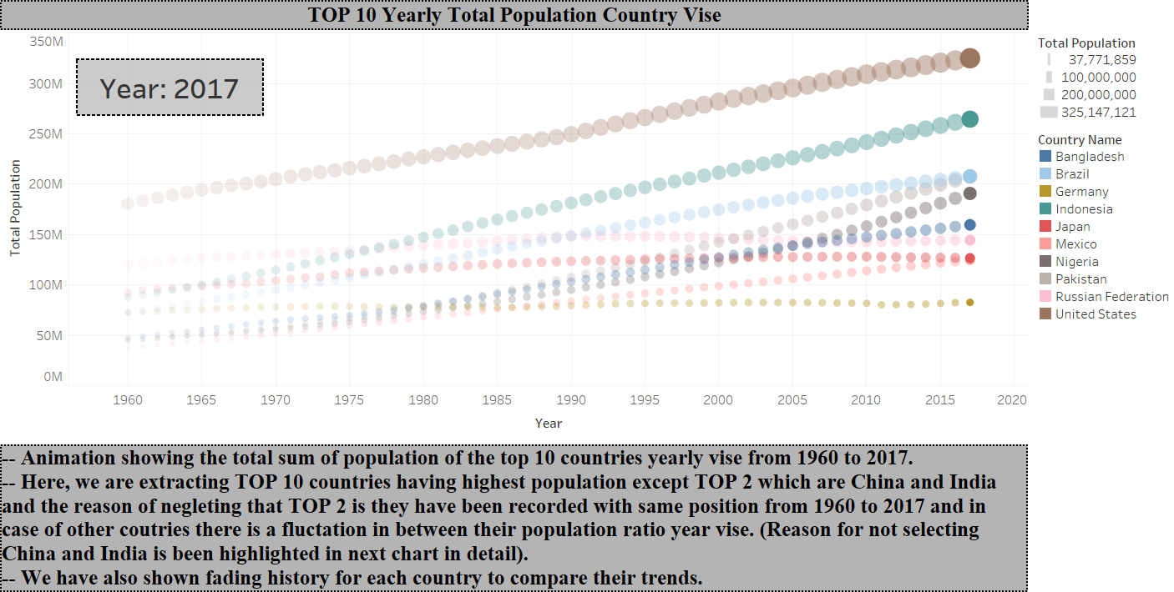
Q.3 - Visualization

Slide 12
Question 3 : TOP 10 Yearly Population Country Vise
It can be observed from the graph that till year 1966, population order of TOP 10 countries has not changed at all.
USA is the country with highest population(3rd, because ignoring China and India) followed by Russian federation until 1974 after which Indonesia becomes country with 4th highest population until 2017.
Remaining 8 countries kept changing their positions throughout the time period for rest of 8 places with Brazil and Pakistan ending at nearly same population in 2017.

Slide 13
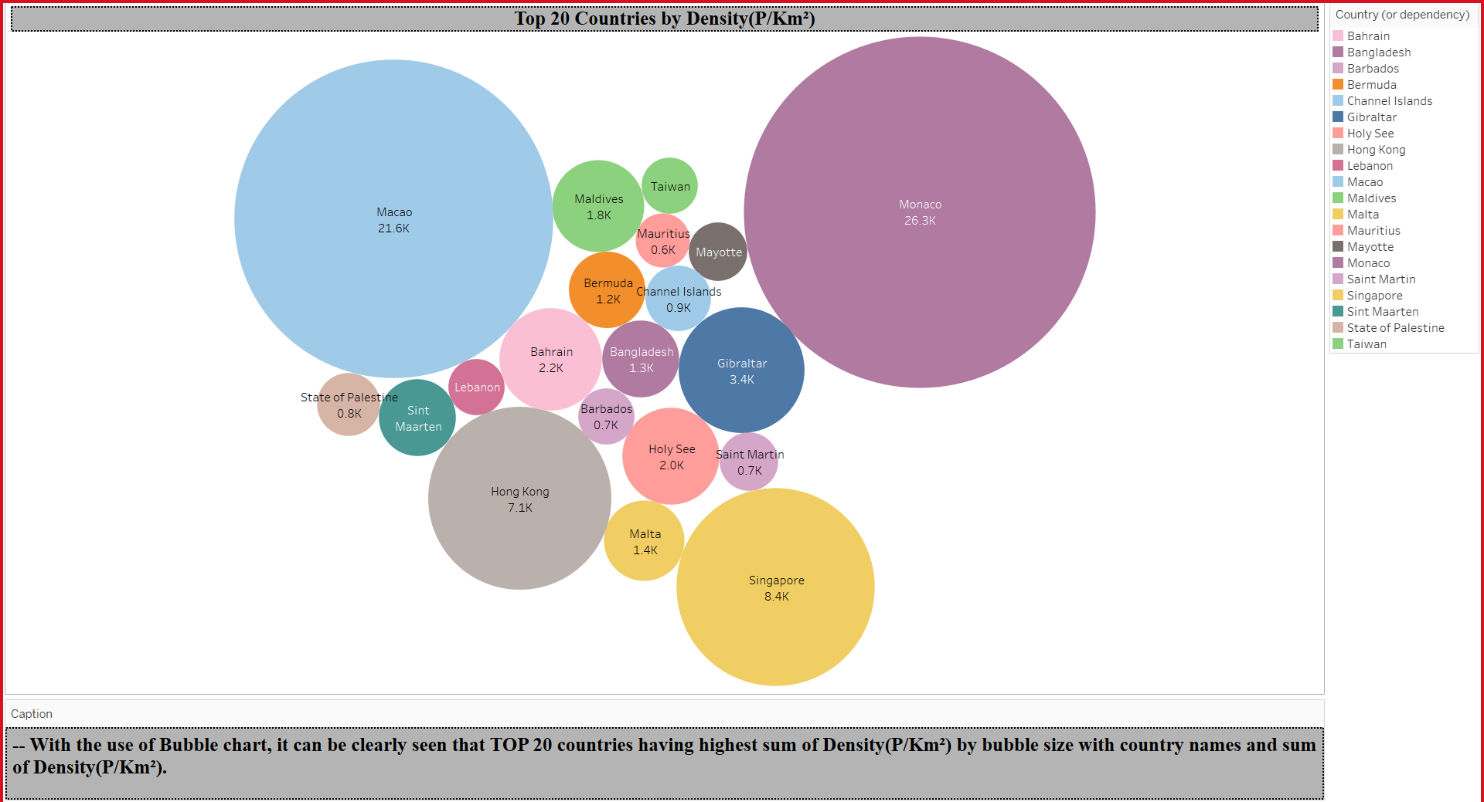
Q.4 - Visualization

Slide 14
Question 4: Top 20 Countries by Density(P/Km²)
It can clearly be concluded from the above graph that Monaco had highest density that is highest people in area of 1 Km².
There were approximately 26,300 people per Km² in Monaco followed by Macao with 21,600 people per Km².

Slide 15
STORY PART
Here, I have created a story showing the changes in fertility rate of the country on the basis of mean age of population of the country and yearly % increase in population.

Slide 16
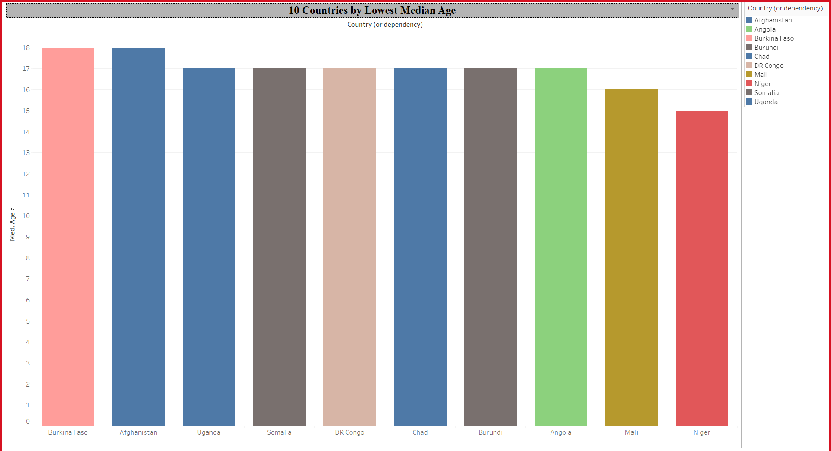
Q.5(1) - Visualization
- Here, I have selected 10 countries(Available Data) with lowest mean age.

Slide 17
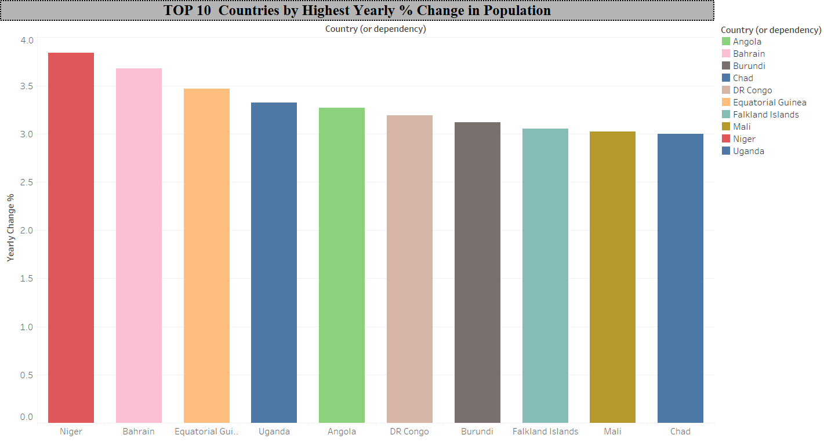
Q.5(2) - Visualization
- This graph shows TOP 10 countries which gain population at highest rate yearly.

Slide 18
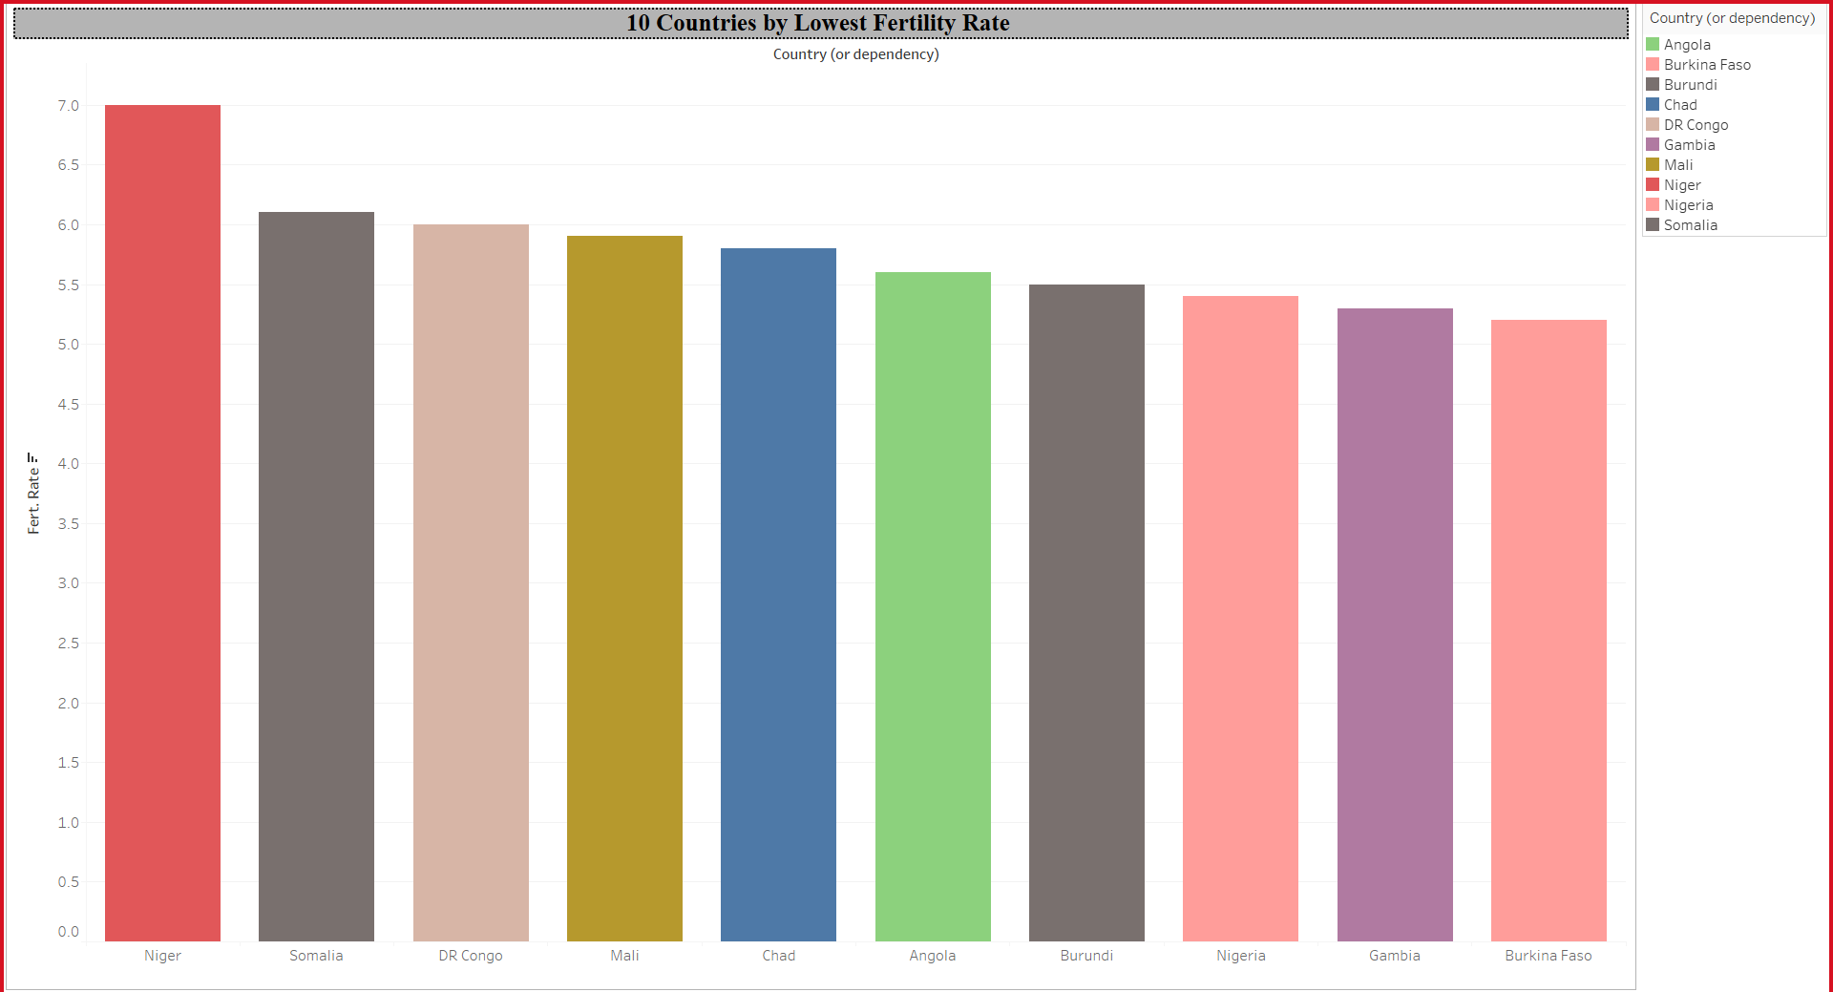
Q.5(3) - Visualization
- This graph shows 10 countries with lowest fertility rate(Available data).

Slide 19
Story insights : Title : Relation of Age, Yearly % Increase Rate and Fertility Rate
It can be clearly observed that out of the 10 countries with lowest mean age and highest yearly % population increase rate, there are 6 countries with the highest fertility rate (Available Data).
So, it can be concluded that lower the age higher the % increase in population as due to higher reproduction rate and the fertility rate is higher as younger people have better health.

Slide 20
Conclusion
Appropriate, titles, legends and captions have been assigned to each graph, as necessary.
Hierarchy of country and continent has been created.
Individual graph has filters, colors as required.
P.S. : We have hidden all the sheets which are being used in dashboards and story.

Slide 21


Thank you!

